Slide 1

ModuleFast: High Performance Powershell Module Installation
Justin Grote
Datacenter Solutions Architect, Microsoft MVP
Allied Digital Services LLC

Slide 2

Many thanks to our sponsors:

Slide 3

Thanks to Allied Digital Services LLC
Global leader with 35 years proven experience I Global Managed IT Services and Transformative Solutions I India’s Leading Master Systems Integrator
Why ADSL?
Core capabilities
Partner to 10 out of Fortune 100
Operating in 70 countries
Delivering complex sustainable projects
Digital Business Transformation DNA
Sound Financials
Consistent growth, QoQ, YoY
Cloud Transformation, DevOps and Engineering
Enterprise Infrastructure Management Services
Systems Integration – IoT, Smart Cities
CyberSecurity Services and Solutions
Service Management Platform, Automation, Mobility
Modern Workplace (End User) Services and Solutions
Differentiators
Awards & Accolades
Outcome based service model
Strategic 360 degree Industry partnerships
Wide spectrum of Technology Skills
Large contract capability, over USD 100M
Center of Excellence in Service Delivery
Systems Integration Capabilities
ISO 27001, ISO 20000, CMMI, SOC 2 Certified
Digital Transformation Platform PinkVerify Certified (ADiTaaS)
“CIO Choice” Award 2021 for managed IT servcies
“Best Under A Billion” Dollar Company by Forbes
“International Excellence Award” by Brands Impact
“Best Smart City Initiative Award” by World CSR
“Architecture Excellence Awards 2016” by ICMG
"Order of Merit - Innovative Smart Solution-Infrastructure“

Slide 4

Why ModuleFast?

Slide 5
Why ModuleFast?
Optimized for CI/CD scenarios where getting modules installed quickly is needed.
Declarative method of installation (Terraform-style)
It was fun ☺

Slide 6
“Learning Experiences” (aka false starts)
Trying to leverage NuGet DLLs
Trying to use Paket as the underlying engine
Shying away from making a new data model

Slide 7
Pwsh.Gallery
Written in Typescript
Built on Cloudflare Workers
Proxies, translates, and caches PSGallery NuGet v2 API to Nuget v3
https://pwsh.gallery
https://github.com/JustinGrote/pwshgallery

Slide 8
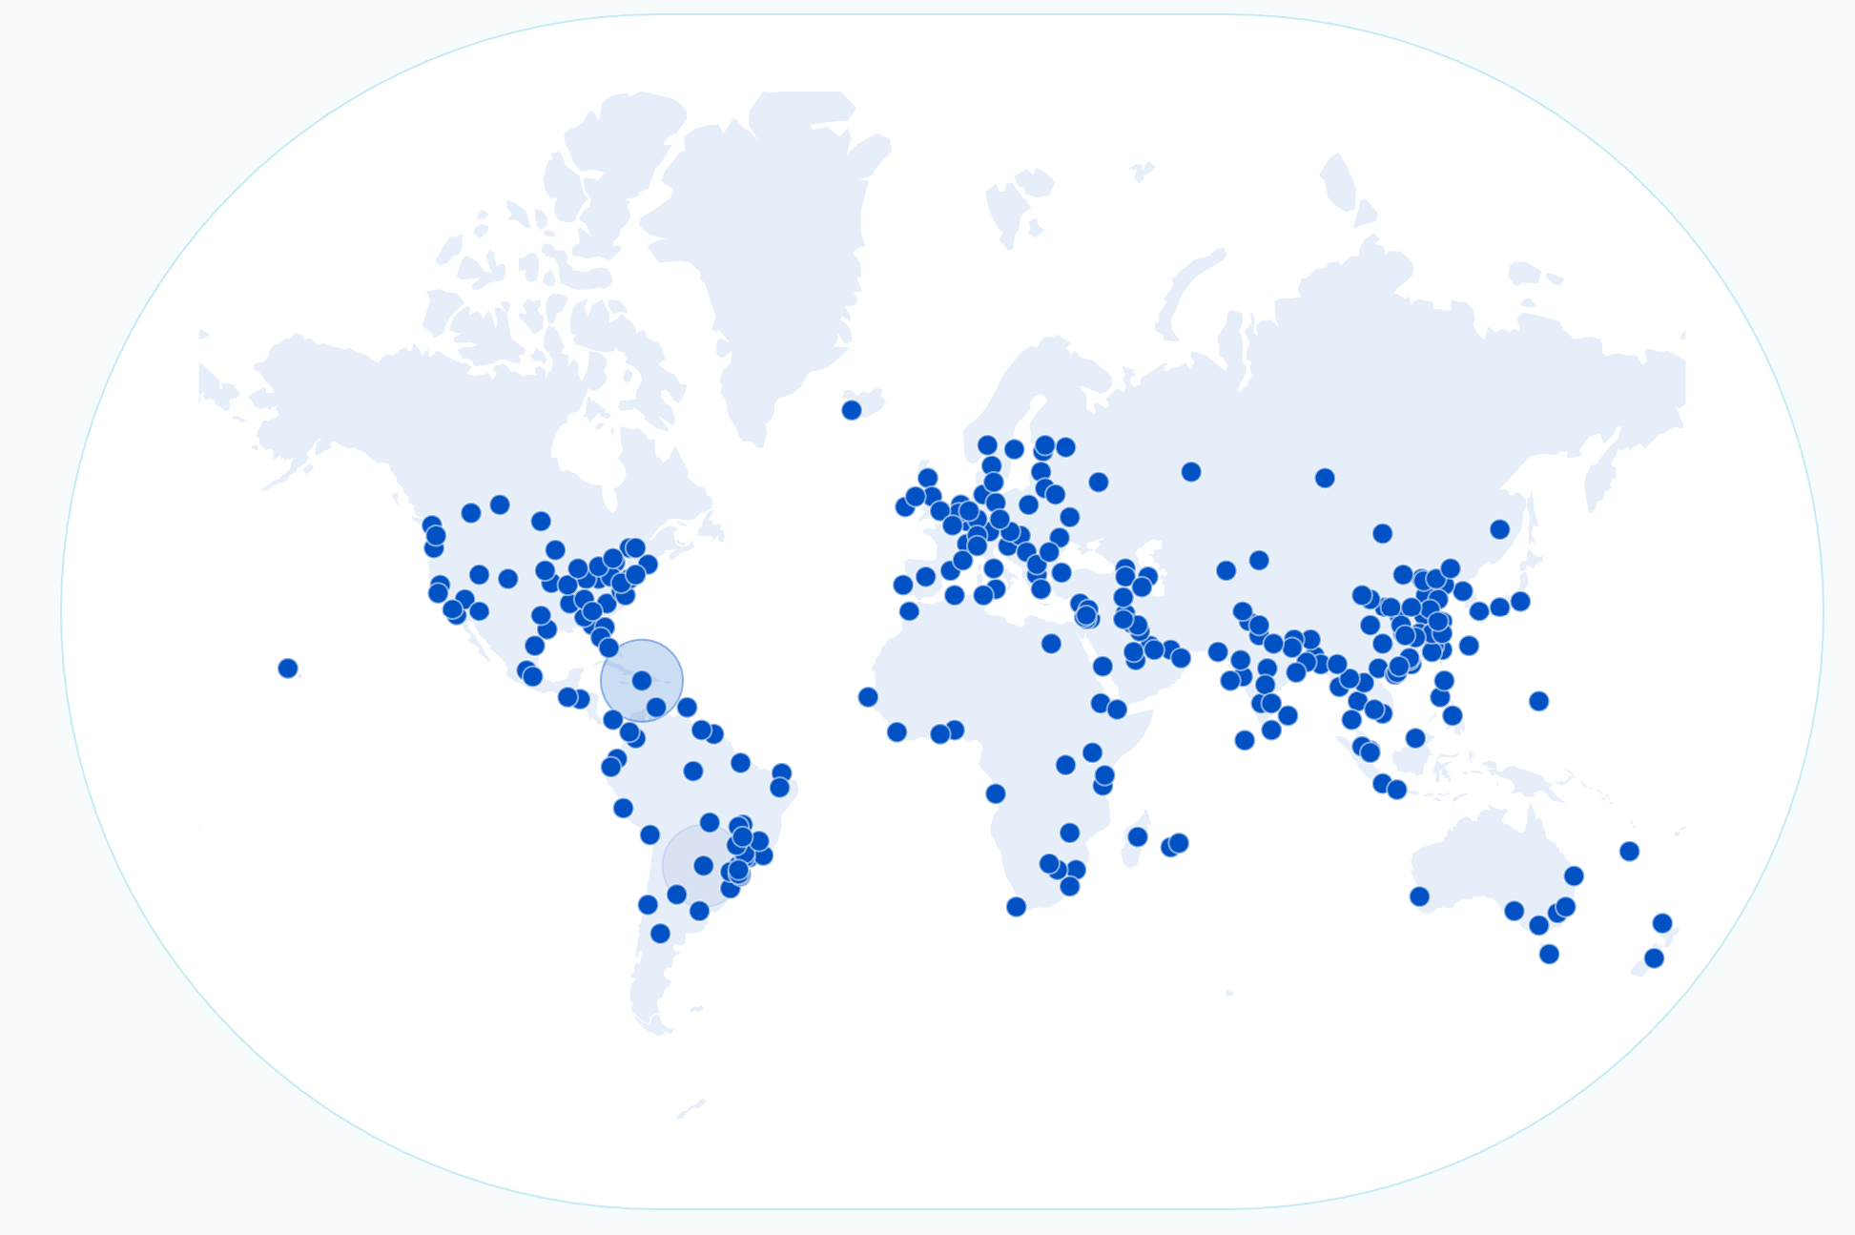
Cloudflare Worker Locations

Slide 9

GitHub Actions Performance
PSGet v2 | PSResourceGet (aka PSGet v3) | ModuleFast
49s | 61s | 15s
Reference GHA
https://github.com/JustinGrote/ModuleFast/actions/workflows/perf.yml

Slide 10
Demo Time!
We love Demos!

